Slide 1

The Australian Housing Market:
AN EXPLORATORY DATA ANALYSIS PROJECT
Laura Hoffmann

Slide 2
Melbourne
Data Cleaning, Exploration and Visualization

Slide 3
Melbourne Cleaning
Check for missing values
Drop rows with missing values under ‘Price’ column
Convert ‘Date’ column to datetime format
To be able to distinguish by Month
Create variables for Price by Month
Prepare for visual purposes
Create variables for Price by Region
Prepare for visual purposes

Slide 4
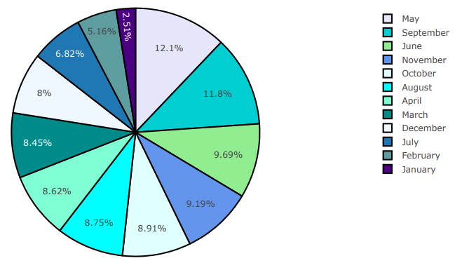
Melbourne Visualization (Months)
Total number of sales broken down by month

Slide 5
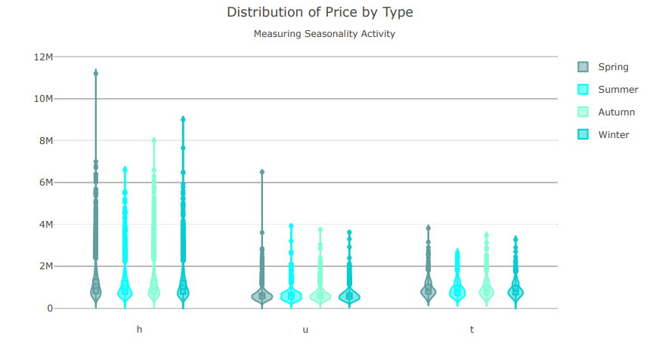
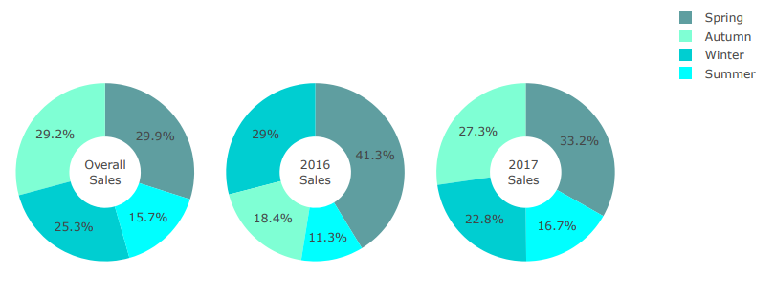
Melbourne Visualization (Seasons)
Sales per season by year
H = House, U = Unit, T = Townhouse

Slide 6
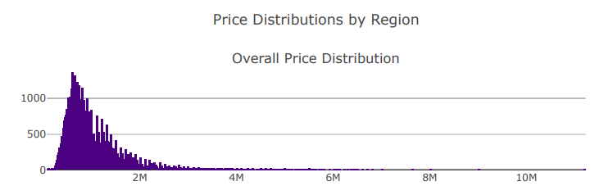
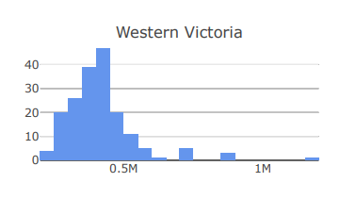
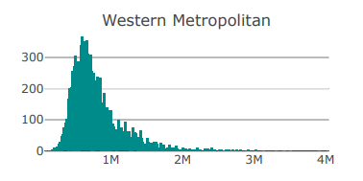
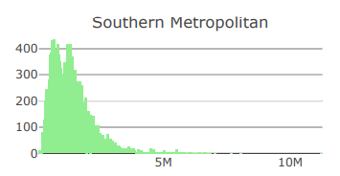
Melbourne Visualization (Regions)
Least expensive distribution
Most expensive distribution

Slide 7
Melbourne Analysis
Spring is the best time to sell
September - November
Summer is the best time to buy
December - February
Regionally
Most expensive: Southern Metropolitan
Least expensive: Western Victoria

Slide 8
Sydney
Brief Data Cleaning, Visualization and Modeling

Slide 9
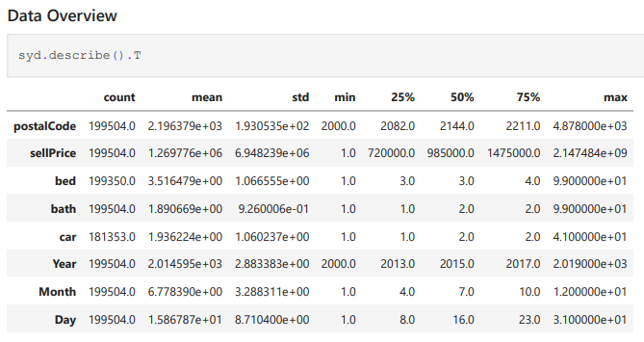
Sydney Cleaning
Data Overview
Statistics
Check for missing values
KNN Imputer to fill in values for car and bed
Convert Date column to datetime format
Create day, month and year variables for visuals

Slide 10
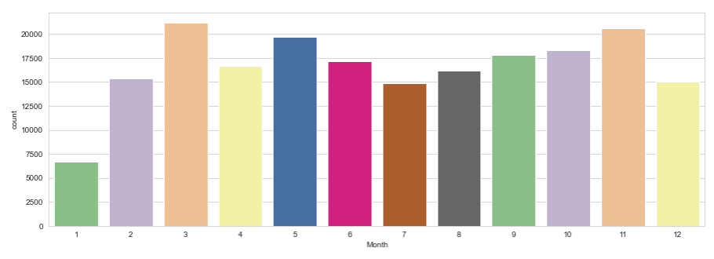
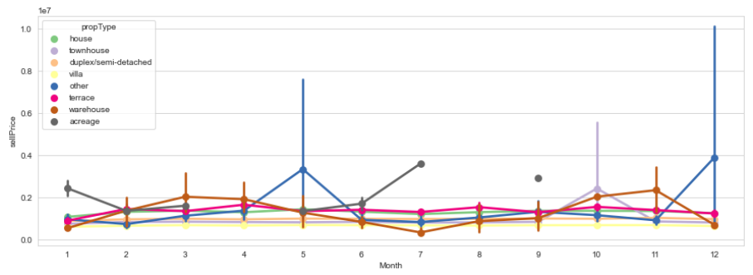
Sydney Visualization
← Count of sales per month
Sell Price per month by property type →

Slide 11
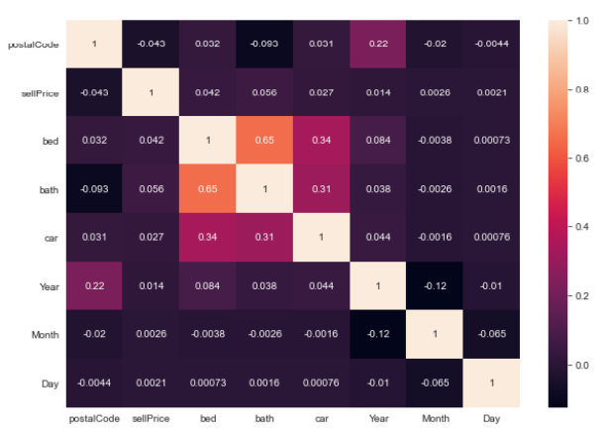
Sydney Visualization (Correlations)
Sydney data variable correlation

Slide 12
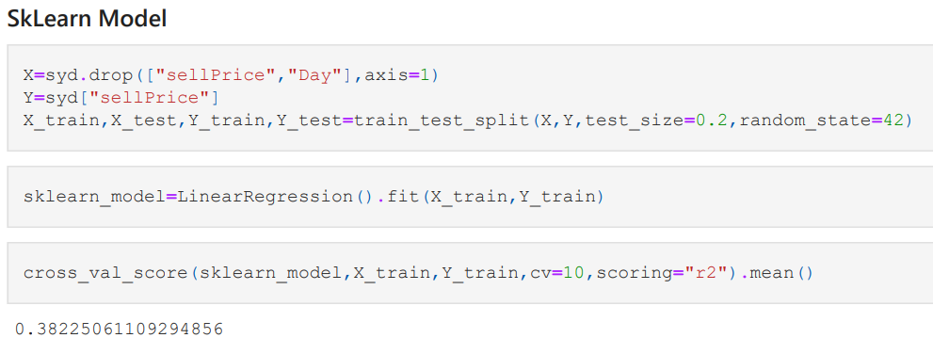
Sydney Modeling
Price Prediction
Linear Regression
Stats Model
SkLearn Model
About 40% accuracy
12

Slide 13
Summer is the best time to buy
December – February, as the market dips
Low correlations with most variables and price
Size of house (bed, bath and garage counts) most highly correlated
Modeling
Region instead of area code would make a bigger difference (one hot encoding for future data)
Sydney Analysis

Slide 14
Conclusion
Buying/selling seasons
Predicting Variables
House size/rooms/baths
Regions/Suburbs
Months/time of year
14

